Slide 1



Lecture 7: Networking
GAM340: Professional Practice
BA(Hons) Game Development

Slide 2
SSLG preamble
‘You said, we did’
Lectures are too long
Lectures are boring
Lectures are confusing

Slide 3
SSLG preamble
‘You said, we did’
Lectures are too long
Lectures are boring
Lectures are confusing
Resumé advice tends to be highly contradictory:
Number of pages
Style (infographic vs. text vs. bullet points vs. highlights)
Value of hobbies and interests / other work etc
Make sure your resumé contains enough information to describe what you have done and what you want to do

Slide 4
GAM340 Assignment 2 ‘Promotional Materials’
Due 18/11/2019
Resumé
LinkedIn portfolio
Professional website
Should have the skeleton of your website in place
& links to other content
Can contain placeholders for your hero pieces

Slide 5
GAM340 Assignment 1 ‘Professional Practice Report’
Hero piece(s)
Peer Review, week 9
Discipline led, done in review sessions
Done in Learning Space
Make sure you have some content for review
Due 12/12/2019 (week 12)
Hero content for your portfolio
Submit a link
-Showcase after xmas (week 13)

Slide 6
GAM320 Assignment 2 ‘Evaluation’
Due 8/11/2019
1,500 word report +/- 10%
Follow the rubric & additional guidance
Use the weighting to work out word count for each section
Using a reflective practice framework may help you to marshal your experiences and thoughts into a plan

Slide 7
GAM320 Assignment 2 ‘Evaluation’
Due 8/11/2019
SMART goals
Think deeply about ‘specific’
‘git gud at art / programming / design / writing’ is not specific
Think about ’measurable’
How will you know when you have improved, either quantitatively or qualitatively?
What is realistic for the time you have available to spend on this?

Slide 8
Learning Outcomes
Develop strategies for building small yet meaningful networks of support
Assess social networks, and those within networks, for their ability and likelihood to support you in a professional manner
Avoid toxic environments

Slide 9
Networking, what do we even mean by networking?

Slide 10
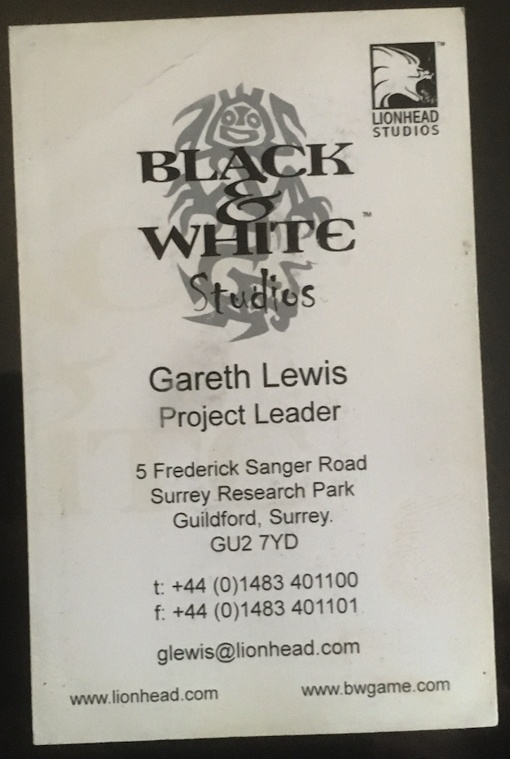
Networking, what do we even mean by networking?
For the people from EGX, did you do any networking with these?
What were your experiences & outcomes?

Slide 11
Networking, what do we even mean by networking?
Traditionally:
Having a huge database of names
Getting in front of people to prospect for business
Schmoozing and boozing
"The process of developing and using your contacts to increase your business, enhance your knowledge, expand your sphere of influence or serve your community.” – Ivan Misner
https://www.entrepreneur.com/article/225067

Slide 12
Networking, what do we even mean by networking?
Traditionally:
Having a huge database of names
Getting in front of people to prospect for business
Schmoozing and boozing
Traditional ‘paper-based’ networking was geared around business cards
Attend meetings specifically to exchange them
Then using them to sell / pitch / schmooze to & with

Slide 13
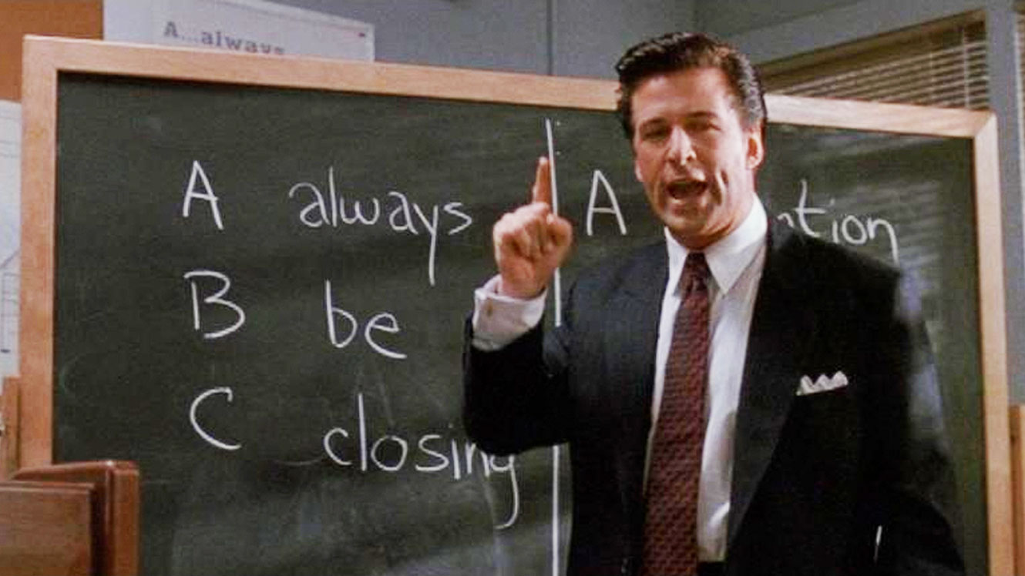
Networking, what do we even mean by networking?
Traditional ‘paper-based’ networking was geared around business cards
And geared around sales
From ‘Glengarry Glen Ross’

Slide 14
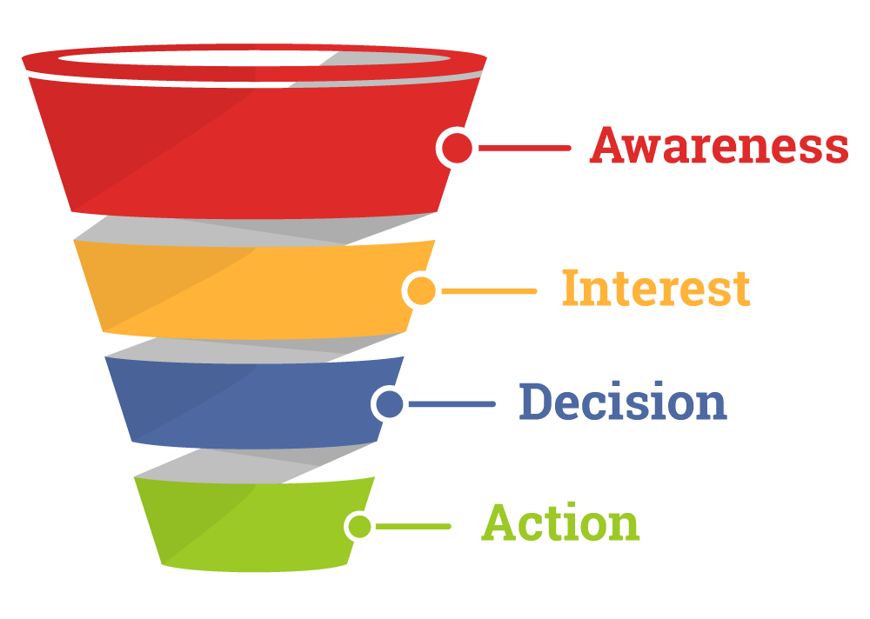
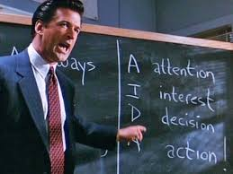
Networking, what do we even mean by networking?
Traditional ‘paper-based’ networking was geared around business cards
And geared around sales

Slide 15
Networking, what do we even mean by networking?
Traditional ‘paper-based’ networking was geared around business cards
And geared around sales
Collect business cards
Perform sales funnel (AIDA & ABC)
This is why shows will have a lot of raffles / lotteries based on business cards
Collect names & details
Sell names, products & services

Slide 16
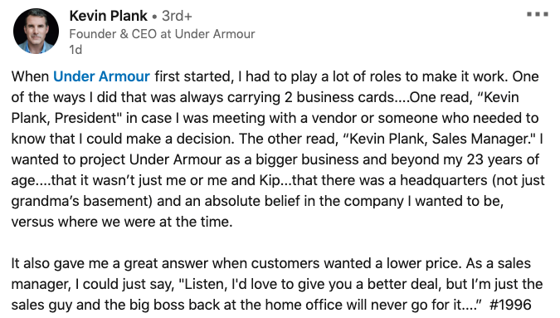
Networking, what do we even mean by networking?
Traditional ‘paper-based’ networking was geared around business cards

Slide 17

Networking, what do we even mean by networking?
Traditional ‘paper-based’ networking was geared around business cards

Slide 18
How can you make traditional networking work for you?

Slide 19
How can you make traditional networking work for you?
Traditional networkers have clear goals
Meet all the people in the room
Get cards from all the ‘prospects’
Organise X follow-on meet ups
This is great if you are a massive extravert

Slide 20
How can you make traditional networking work for you?
What do you want to achieve from your traditional networking activities?

Slide 21
How can you make traditional networking work for you?
What do you want to achieve from your traditional networking activities?
What if I hate the idea of spending a lot of time in a room of strangers?
From MBTI
E (extravert) means you get ‘energy’ from events / people
I (introvert) events / people are likely to drain you
https://www.myersbriggs.org/my-mbti-personality-type/mbti-basics/extraversion-or-introversion.htm

Slide 22
How can you make traditional networking work for you?
What do you want to achieve from your traditional networking activities?
If you are an introvert, look to limit the amount of work you do
Other forms of networking may help you better, we will look at those later.

Slide 23
How can you make traditional networking work for you?
What do you want to achieve from your traditional networking activities?
Work out what your goals are and then work out how to achieve them
Where are you at?
Where do you want to be?
How are you going to get there?

Slide 24
How can you make traditional networking work for you?
Where are you at?
Where do you want to be?
How are you going to get there?
I’m looking for a job | Getting interviews | Take loads of business cards with a link to your resume / portfolio on them and give them to companies / recruiters Hand them out like confetti
I have a game pitch to publish (book a demo stand!) | Getting meetings with publishers | Take cards / flyers with game details Take videos of game (mobile) Take demo of game (laptop)
I’m looking to build relationships with other developers | Building my social network | Take loads of business cards and go drinking / go to relevant sessions Consider taking up smoking / vaping as a social lubricant

Slide 25
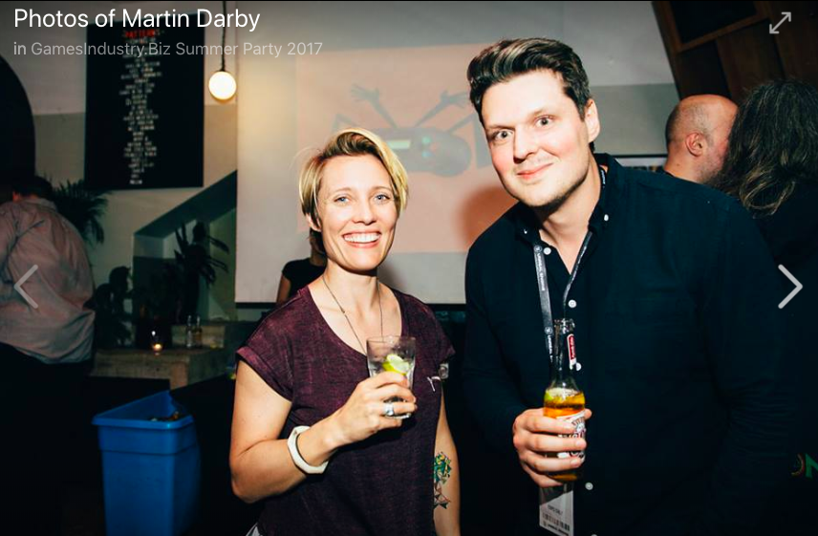
How can you make traditional networking work for you?

Slide 26
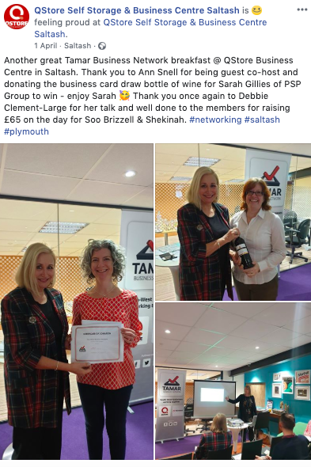

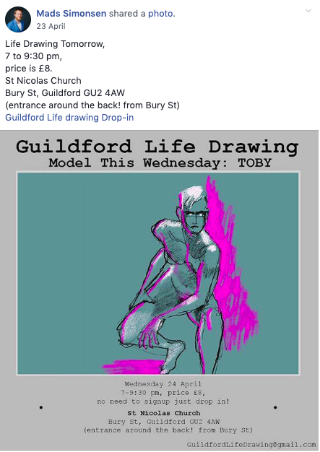
How can you make traditional networking work for you?
Choose your traditional networking events carefully!

Slide 27
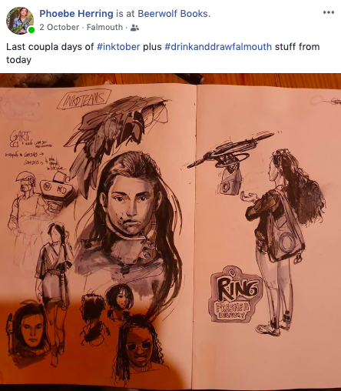
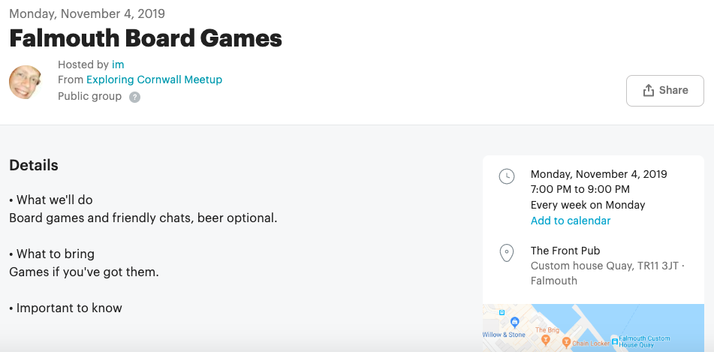


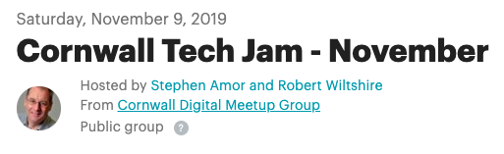
How can you make traditional networking work for you?
Choose your traditional networking events carefully!

Slide 28
Non-traditional networking

Slide 29

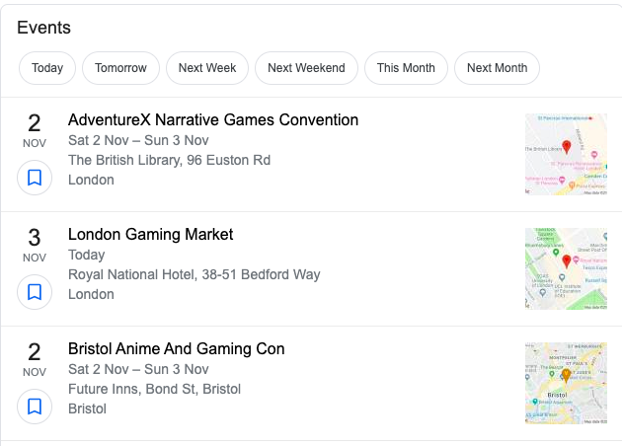

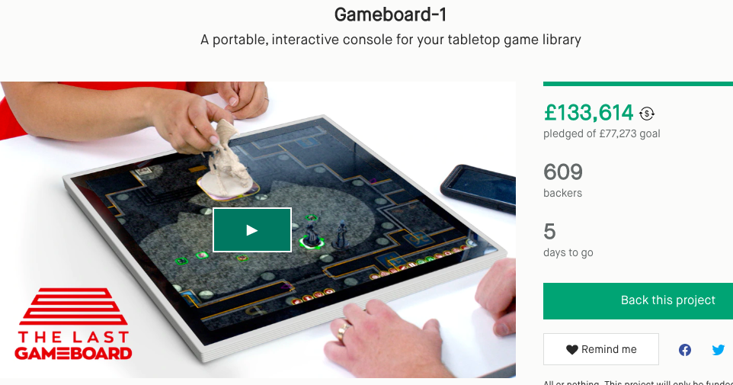
Non-traditional networking
Are these relevant?
Having a huge database of names
Getting in front of people to prospect for business
Schmoozing and boozing

Slide 30
Non-traditional networking
Social media based-networking
Can work better if you are an introvert
Asynchronous nature of communication means you can engage at your leisure
Digital nature of communication means reduces FOMO

Slide 31
Non-traditional networking
Social media based-networking
Where are you at?
Where do you want to be?
How are you going to get there?
I’m looking for a job | Getting interviews | Follow game companies Follow recruitment companies Follow game developers at companies you find interesting / would like to work for (Build a portfolio of relevant content, post it on relevant fora) Engage on relevant fora

Slide 32
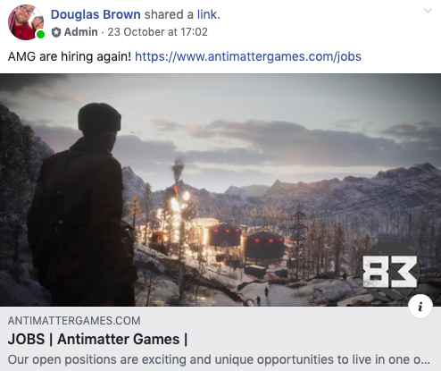
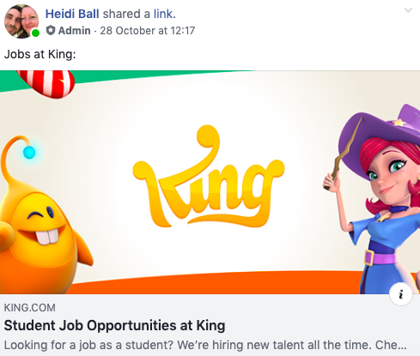
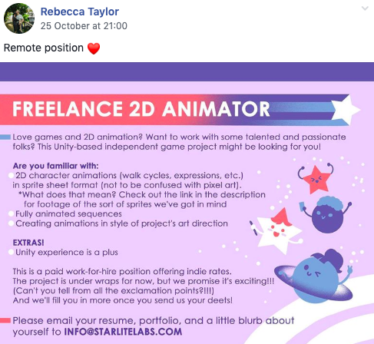

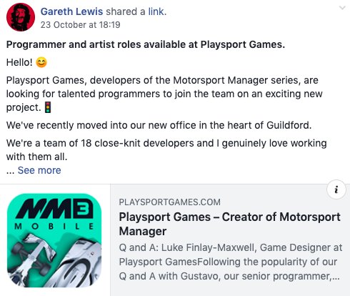


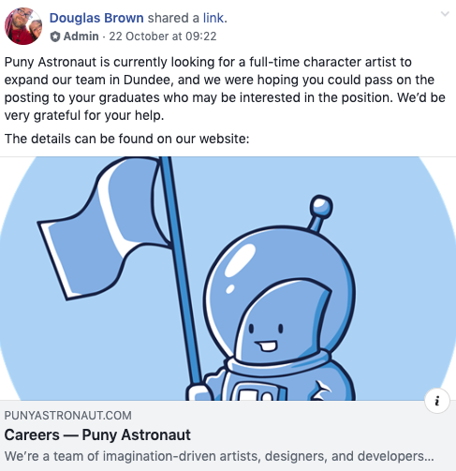
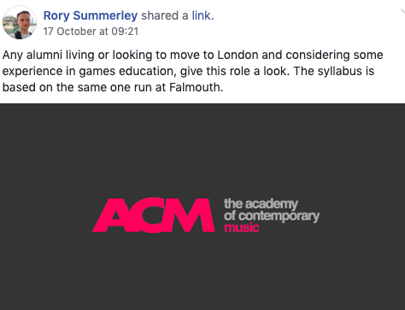
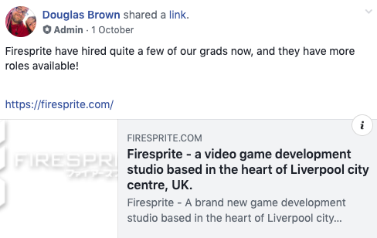
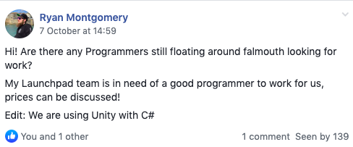
Non-traditional networking
Postings in facebook/Falmouth Games Academy Alumni (Oct)

Slide 33
Non-traditional networking
Social media based-networking
Where are you at?
Where do you want to be?
How are you going to get there?
I have a game pitch to publish | Generate interest | Create suitable groups on social media to publicise development & game Build networks with other indie gamedevs Follow publishers & game funders Follow influencers

Slide 34
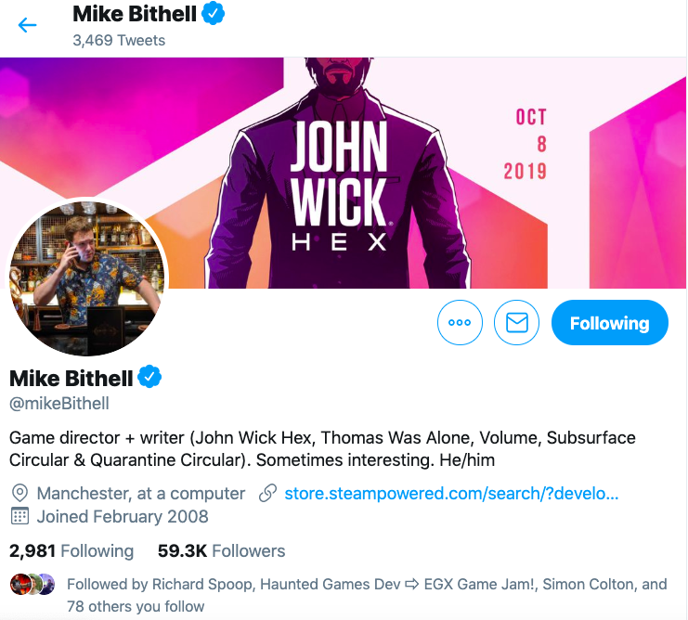

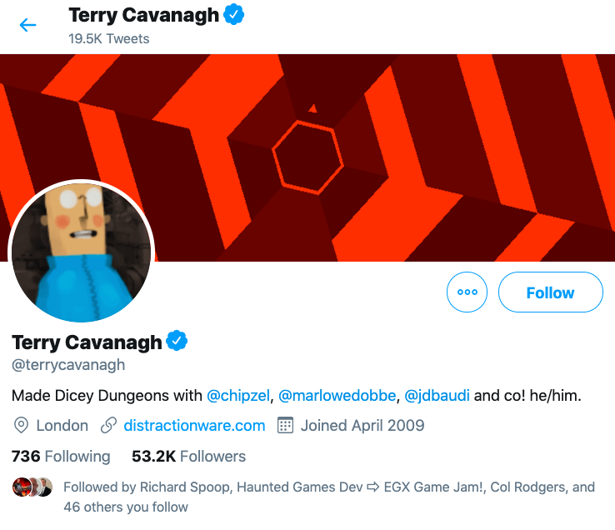
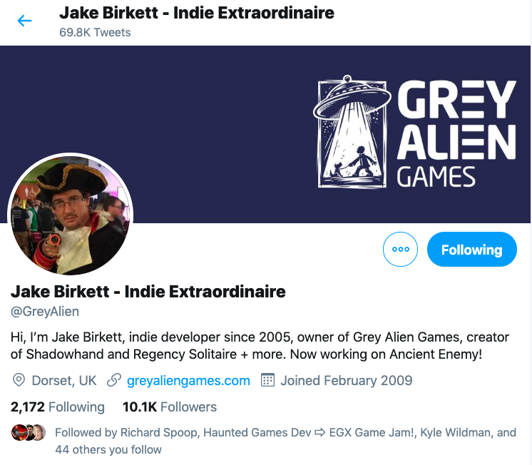
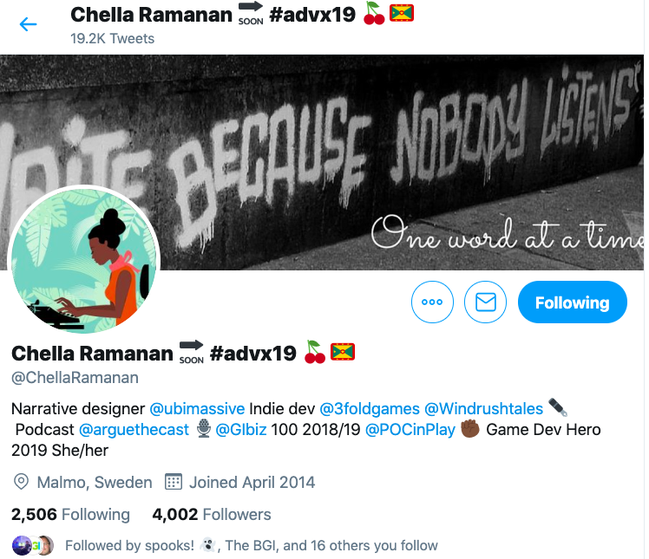
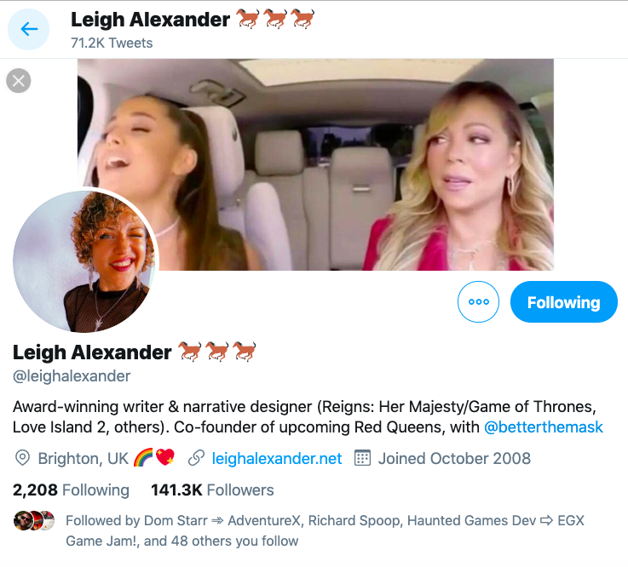
Non-traditional networking
Social media based-networking

Slide 35
Non-traditional networking
Social media based-networking
Where are you at?
Where do you want to be?
How are you going to get there?
I’m looking to build relationships with other developers | Building my social network | Join networks of developers Connect with developers Share interests and approaches Engage in suitable interest groups

Slide 36
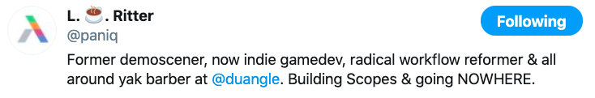
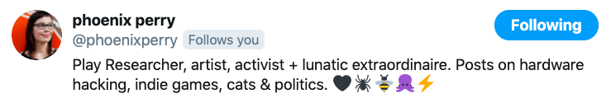
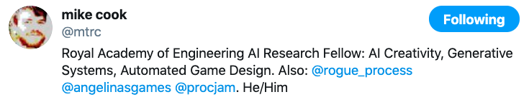
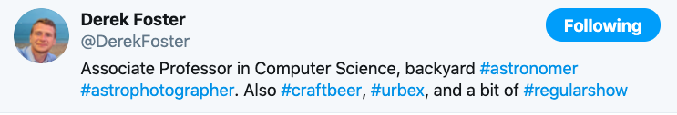
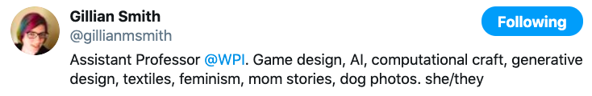
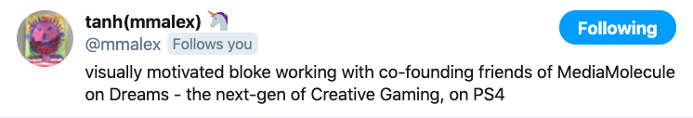
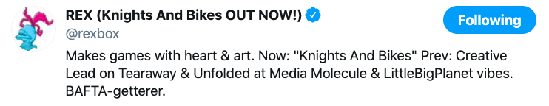
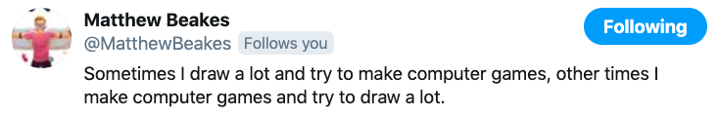
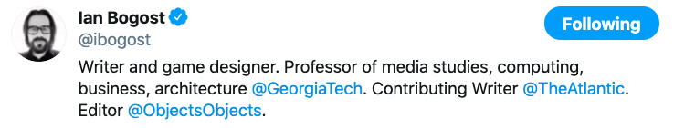
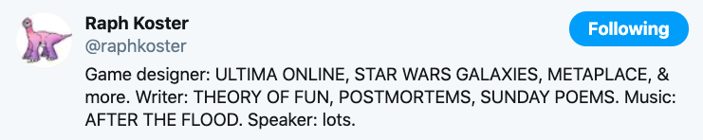
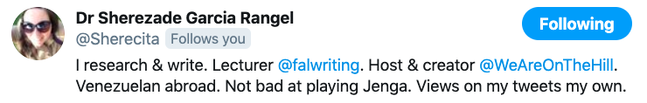
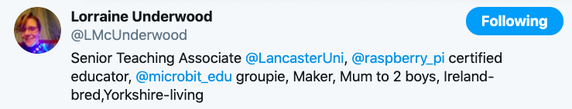
Non-traditional networking
Social media based-networking

Slide 37
Wrap-up
‘Traditional’ networking may not suit your needs as a creative professional
Given it’s (generally) all about selling
Particularly if you are a typical introvert
However, can use it to achieve your goals
If you know what your goals are

Slide 38
Wrap-up
Digital networking may suit your needs as a creative professional
Far less definition of what digital networking ‘does’
Particularly if you are a typical introvert
However, can use it to achieve your goals
If you know what your goals are

Slide 39
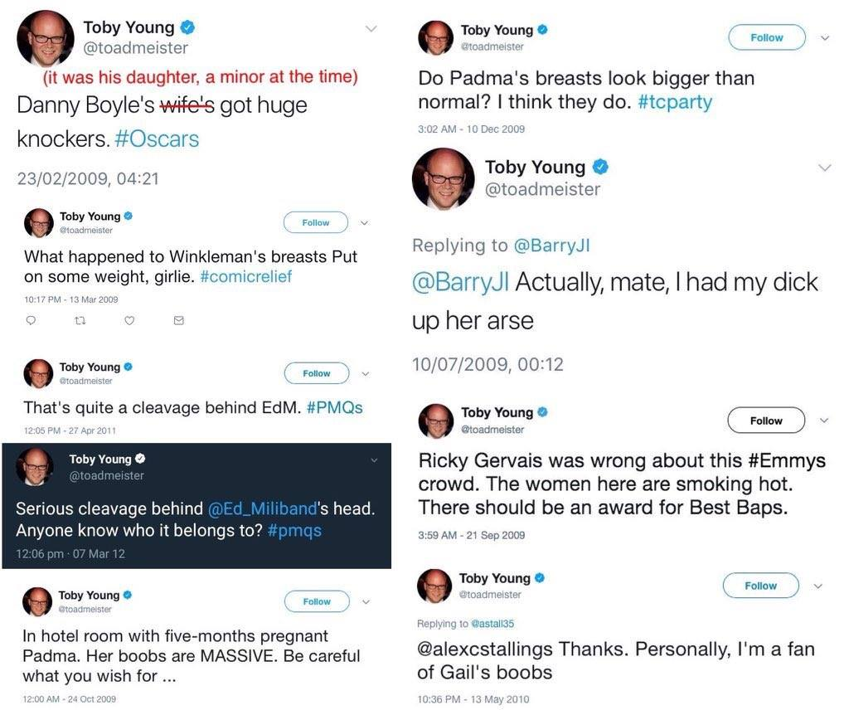
Wrap-up
For both forms, the best advice is
‘Don’t be a dick’ – Rich Barham
And remember, your digital footprints can cast a long shadow
https://www.nytimes.com/2015/02/15/magazine/how-one-stupid-tweet-ruined-justine-saccos-life.html

Slide 40
Questions

